Slide 1
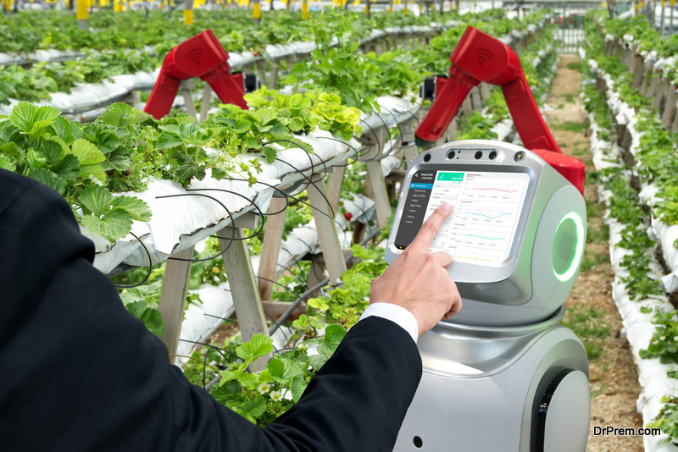
IMPACT OF CLIMATE ON FARMING
By
V.Hema chandrika
T.Akhila

Slide 2
PROBLEM STATEMENT
This project aims to explore various strategies and technologies that can be used to protect crops from the impacts of climate change, including extreme weather conditions
.

Slide 3

RESPONSIBLE CONSUMPTION AND PRODUCTION
UNITED NATIONS :
Sustainable development goal

Slide 4

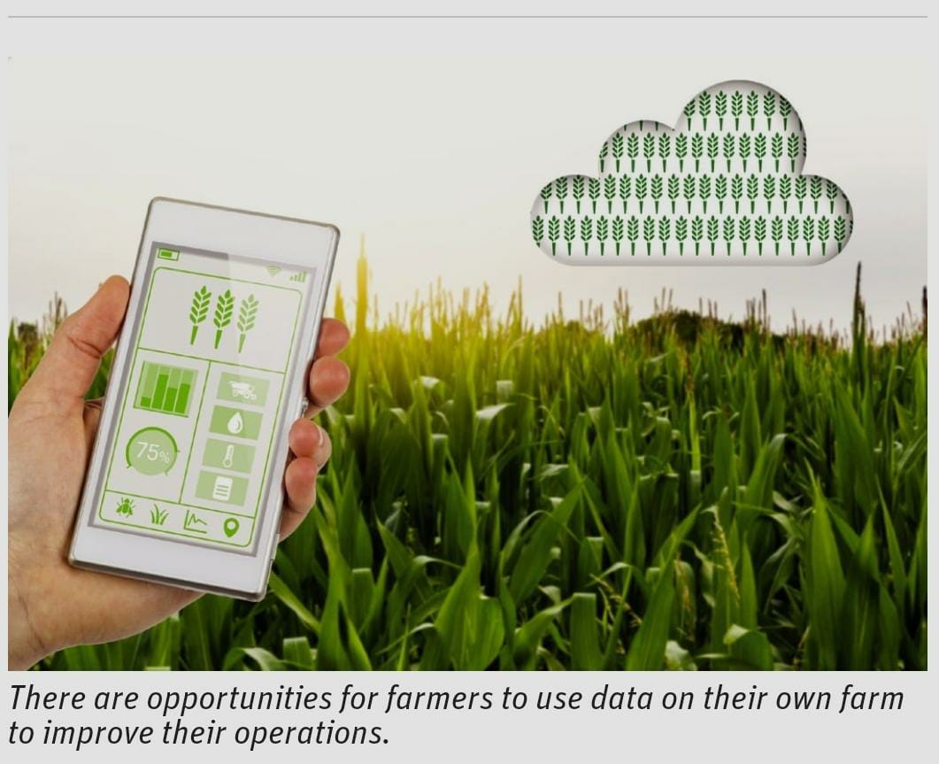
AGRICULTURE SUSTAINABILITY

Slide 5
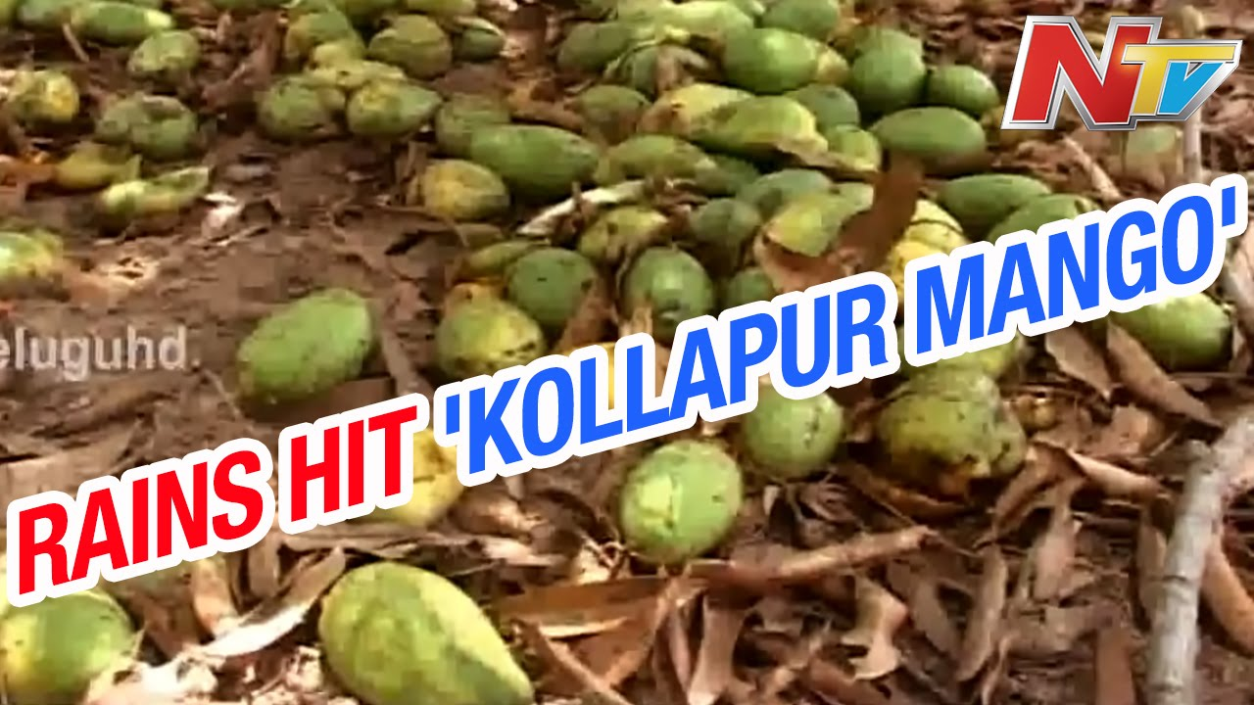
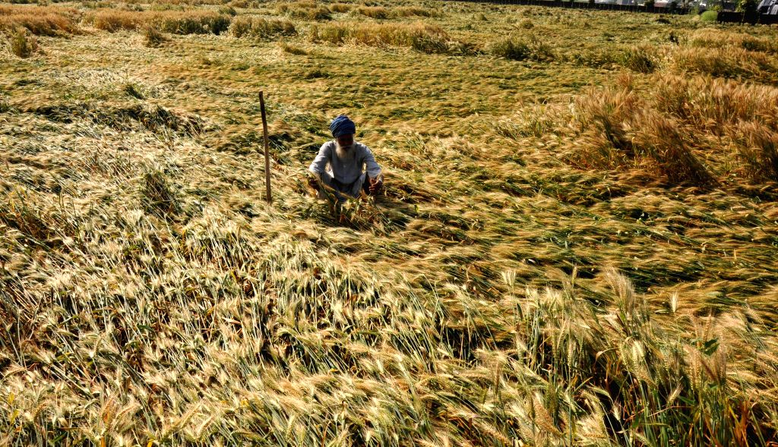
This can be prevented

Slide 6
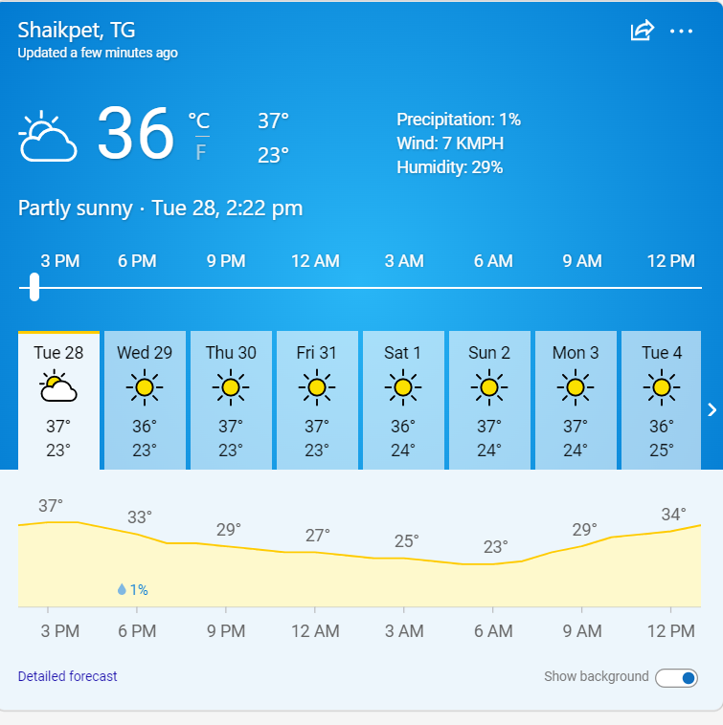
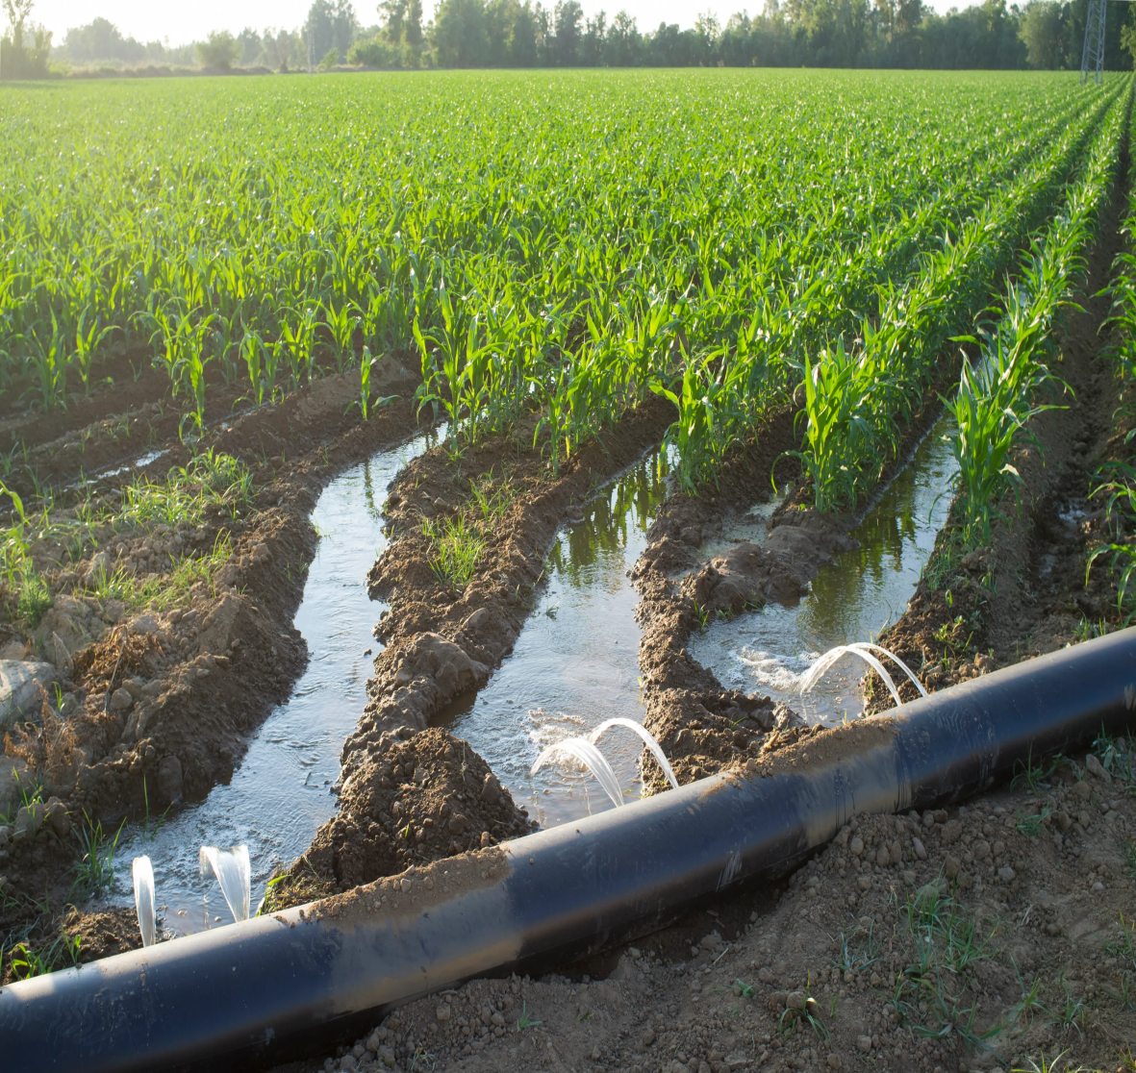
WEATHER PREDICTION AND AGRICULTURE

Slide 7

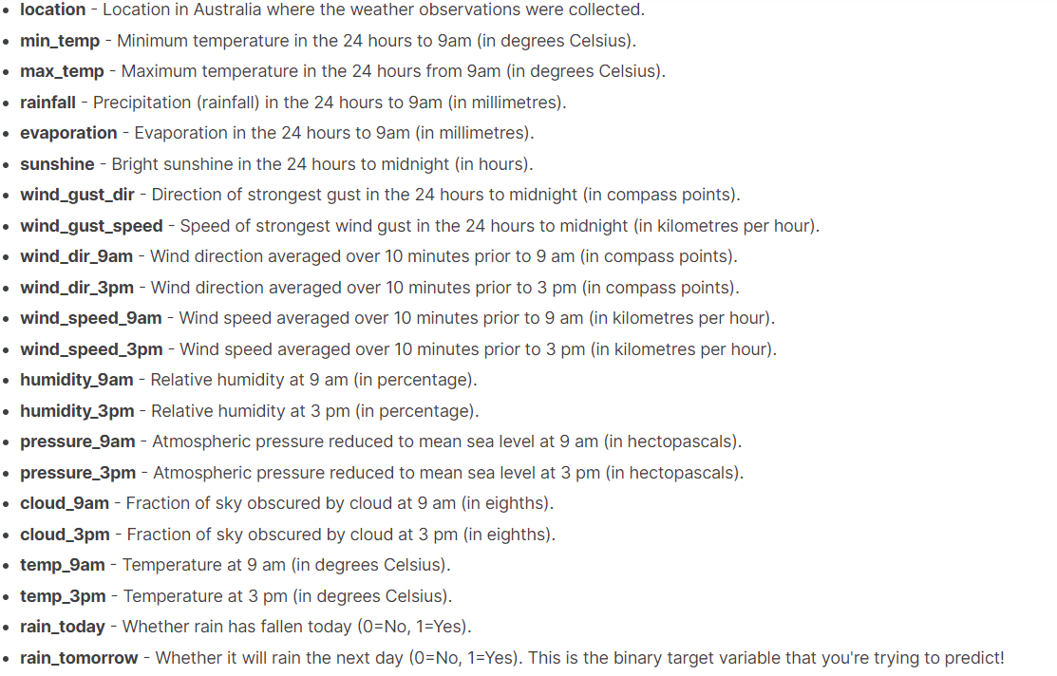
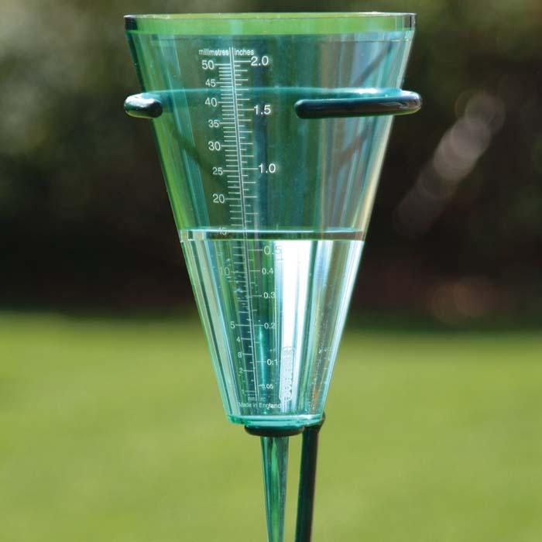
RAINFALL PREDICTION

Slide 8

APIs USED

Slide 9
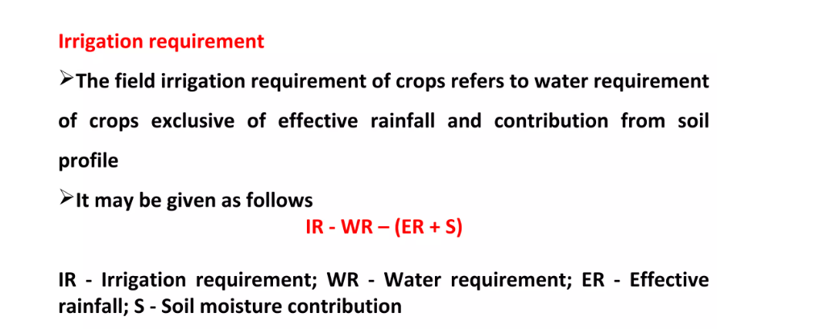
Data sets
Amount of Water needed for plant (From Kaggle, bolt IOT devices)
Rainfall and climate predictions( From: Kaggle _Rainfall Prediction Challenge | Kaggle)
Calculating the amount of water need before the expected heavy rains.(Trained machine learning model)

Slide 10
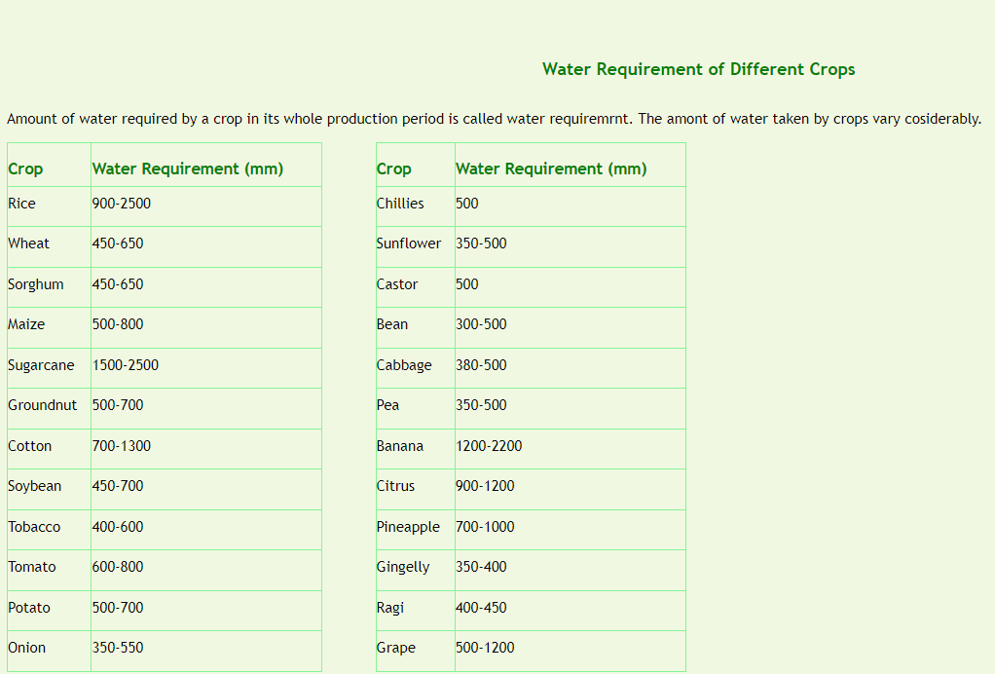

Slide 11
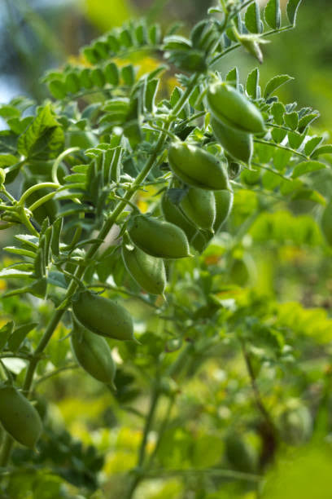
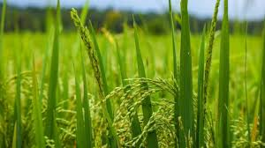
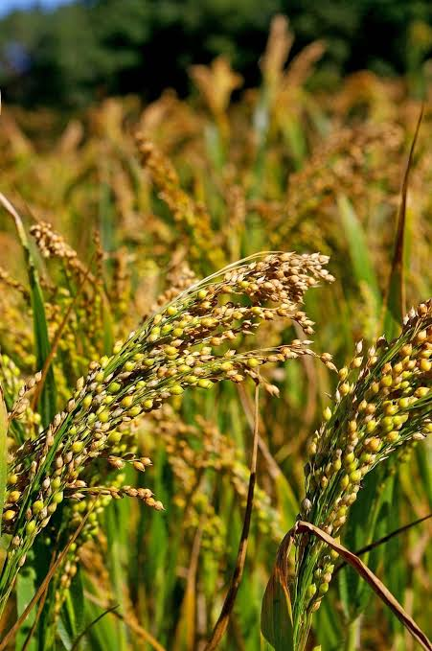
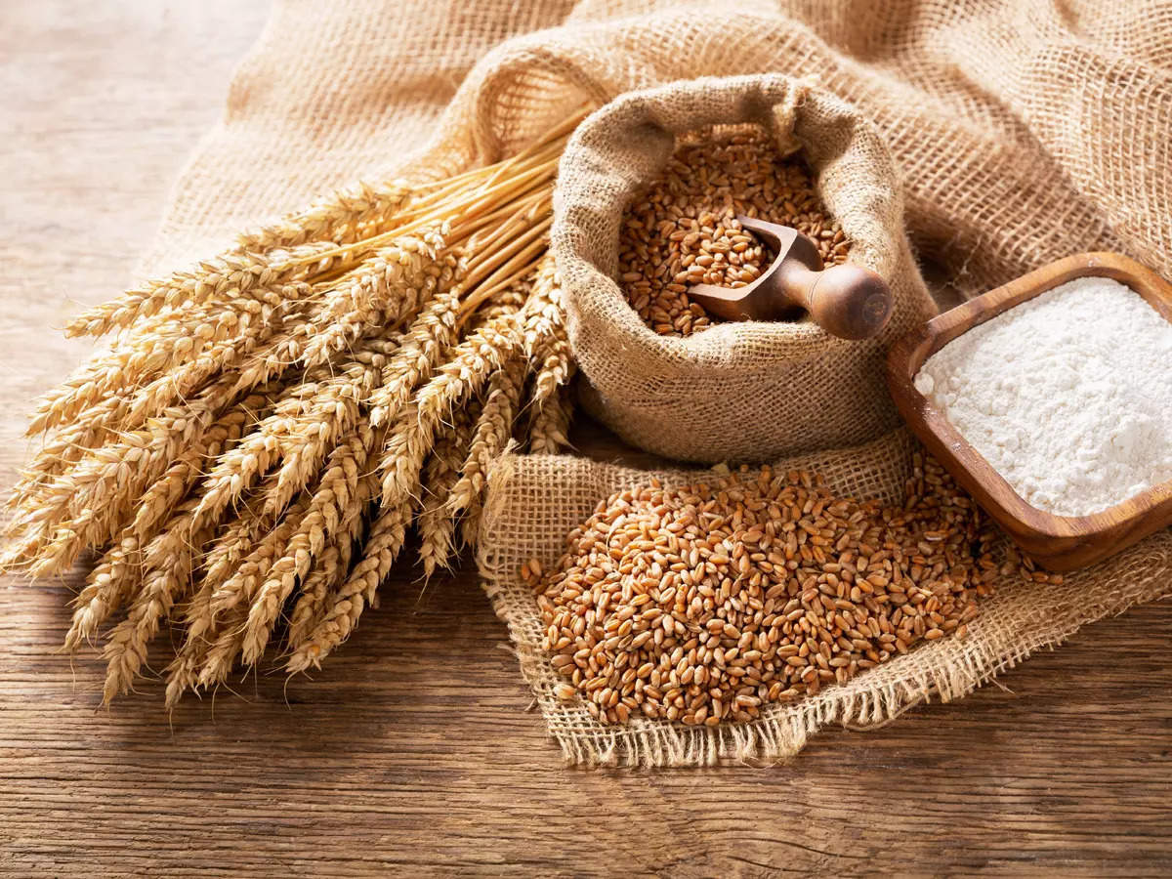

Slide 12
IMPLEMENTATION
DOMAIN:
IOT, Machine Learning
Expected accuracy: 86%
Event Driven architecture:-
event producer : weather api (checks for rain or heavy winds)
event consumer : farmers (receive a message)
Language used: Python
Tools: Google colab, maps api, weather api.

Slide 13
FUTURE GOALS
Scope: Long term predictions - about 6months
Using IOT devices for accurate prediction of weather.
Quantum computing.

